Slide 1
Guide to Programming with Python
Chapter Ten
GUI Development: The Mad Lib Program

Slide 2
Objectives
Work with a GUI toolkit
Create and fill frames
Create and use buttons
Create and use text entries and text boxes
Create and use check buttons
Create and use radio buttons
Guide to Programming with Python

Slide 3
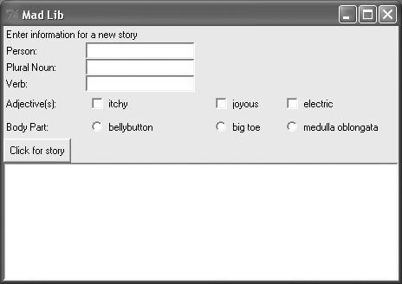
The Mad Lib Program
Figure 10.1: Sample run of the Mad Lib program
A nicely laid-out GUI awaits the user’s creativity.
Guide to Programming with Python

Slide 4
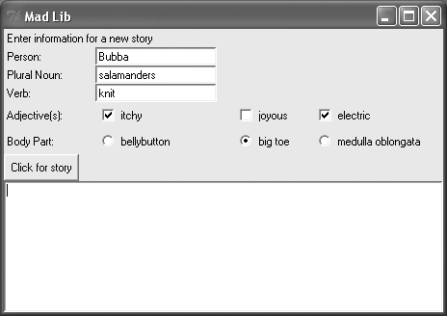
The Mad Lib Program (continued)
Figure 10.2: Sample run of the Mad Lib program
The user has entered all of the necessary information.
Guide to Programming with Python

Slide 5
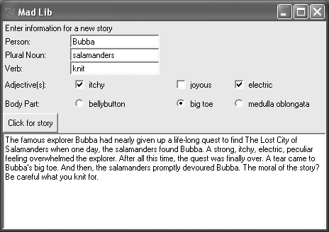
The Mad Lib Program (continued)
Figure 10.3: Sample run of the Mad Lib program
After clicking Click for story button, text box displays masterpiece.
Guide to Programming with Python

Slide 6
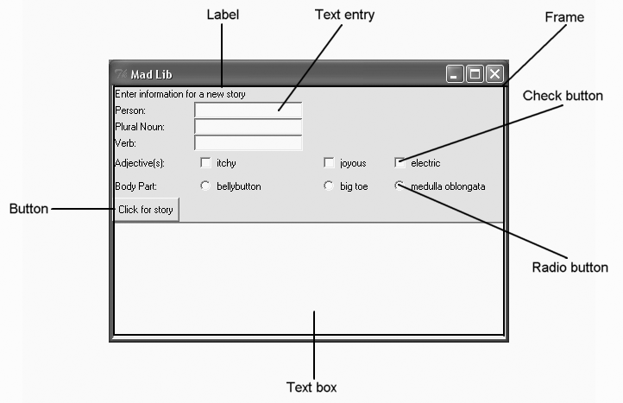
Examining A GUI
Figure 10.4: Examining a GUI
You’ll learn to create all of these GUI elements.
Guide to Programming with Python

Slide 7
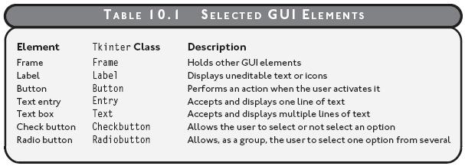
Examining A GUI (continued)
Table 10.1: Selected GUI Elements
Guide to Programming with Python

Slide 8
Understanding Event-Driven Programming
Event-driven program: A program that responds to actions regardless of the order in which they occur
Event: Something that happens involving a program's objects
Event handler: Code that runs when a specific event occurs
Bind: To associate an event with an event handler
Event loop: A loop that checks for events and calls appropriate event handlers when they occur
Guide to Programming with Python

Slide 9
Understanding Event-Driven Programming (continued)
GUI programs traditionally event-driven
Mad Lib without event-driven programming
  Ask series of questions with raw_input() function
  Ask for name of a person, plural noun...
  User must provide each piece of information, in order
Mad Lib with event-driven programming
  Can use a GUI
  User can enter the information in any order
Guide to Programming with Python

Slide 10
Using A Root Window
Root Window
  Foundation of GUI program
  Foundation upon which to add all other GUI elements
  Like root of tree, anchors all other parts
Guide to Programming with Python

Slide 11
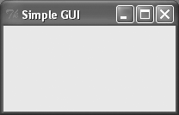
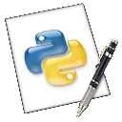
The Simple GUI Program
Figure 10.5: Sample run of the Simple GUI program
The program creates only a lone window.
simple_gui.py
Guide to Programming with Python

Slide 12
The Simple GUI Program (continued)
GUI programs can generate console window too
Console window helpful to see error messages
On Windows machine can suppress console window by changing program extension from py to pyw
Guide to Programming with Python

Slide 13
Importing the Tkinter Module
from Tkinter import *
Tkinter is a GUI module
Imports all Tkinter into global scope
Normally, avoid this kind of import
Some modules designed to be imported this way
Saves typing and makes for cleaner code
Guide to Programming with Python

Slide 14
Creating a Root Window
root = Tk()
To create a root window, instantiate object of the Tkinter class Tk
Because of from Tkinter import *, no need to prefix the module name
Guide to Programming with Python

Slide 15
Modifying a Root Window
root.title("Simple GUI")
root.geometry("200x100")
title()
  Sets title of root window
  Takes string
geometry()
  Sets size of the root window
  Takes string (not integers) for window’s width and height, separated by the "x" character
Guide to Programming with Python

Slide 16
Entering a Root Window’s Event Loop
root.mainloop()
Root window's event loop entered
Window stays open, waiting to handle events
Guide to Programming with Python

Slide 17
Using Labels
Widget: GUI elements (short for "window gadget")
Label widget
  Uneditable text or icons (or both)
  Often used to label other widgets
  Unlike most other widgets, labels aren’t interactive
Guide to Programming with Python

Slide 18

The Labeler Program
Figure 10.7: Sample run of the Labeler program
A label can provide information about a GUI.
labeler.py
Guide to Programming with Python

Slide 19
Creating a Frame
app = Frame(root)
Master: A widget that contains other widgets
Layout Manager: Controls arrangement of widgets
Frame is widget that can hold other widgets
When creating widget, must pass its master to constructor of new object
Here, root is master that contains app
Guide to Programming with Python

Slide 20
Creating a Frame (continued)
app.grid()
grid()
  Method that all widgets have
  Associated with grid layout manager
  Can be used to create desired layout of widgets
Guide to Programming with Python

Slide 21
Creating a Label
lbl = Label(app, text = "I'm a label!")
lbl.grid()
Label Class
  For a label widget
  Master is first argument passed to constructor
  text parameter for widget's text
  grid() method invoked ensures widget visible (places widget at a default location in frame if called with no arguments)
Guide to Programming with Python

Slide 22
Using Buttons
Button widget
  Is a button in GUI
  Can be activated by user to perform some action
Guide to Programming with Python

Slide 23
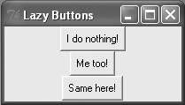
The Lazy Buttons Program
Figure 10.8: Sample run of the Lazy Buttons program
You can click these lazy buttons all you want; they won’t do a thing.
lazy_buttons.py
Guide to Programming with Python

Slide 24
Creating Buttons
bttn1 = Button(app, text = "I do nothing!")
bttn1.grid()
Button Class
  For a button widget
  Master is first argument passed to constructor
  text parameter for widget's text
  grid() method invoked ensures widget visible
Guide to Programming with Python

Slide 25
Creating Buttons (continued)
bttn2 = Button(app)
bttn2.grid()
bttn2.configure(text = "Me too!")
Can add blank button to the frame
configure() method sets or changes widget options
  Useful for changing widget after it has been instantiated
Guide to Programming with Python

Slide 26
Creating Buttons (continued)
bttn3 = Button(app)
bttn3.grid()
bttn3["text"] = "Same here!"
Can access widget's options through dictionary-like interface
Key for option is name of the option as a string
Here, set third button's text option to "Same here!”
Useful for changing widget after it has been instantiated (like .config())
Guide to Programming with Python

Slide 27
Creating a GUI Using a Class
Organizing code into classes can make programming easier
Often beneficial to write larger GUI programs in OOP style
Guide to Programming with Python

Slide 28
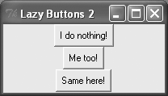
The Lazy Buttons 2 Program
Figure 10.9: Sample run of the Lazy Buttons 2 program
Program appears the same but significant changes under the hood.
Guide to Programming with Python

Slide 29
Defining the Application Class
class Application(Frame):
""" A GUI application with three buttons. """
def __init__(self, master):
Instead of instantiating Frame object, will instantiate Application object
Application object becomes just a specialized type of Frame object
master will be the Tk window that the frame belongs to (root in all our examples so far)
Guide to Programming with Python

Slide 30
Defining a Constructor Method
def __init__(self, master):
Frame.__init__(self, master)
self.grid()
self.create_widgets()
Frame constructor called first
  This is what is used instead of super() for old object classes
Pass Application object’s master, so it gets properly set as master
Invoke Application object’s create_widgets() method
Guide to Programming with Python

Slide 31
Defining a Method to Create the Widgets
def create_widgets(self):
self.bttn1 = Button(self,
text = "I do nothing!")
self.bttn1.grid()
self.bttn2 = Button(self)
self.bttn2.grid()
self.bttn2.configure(text = "Me too!")
self.bttn3 = Button(self)
self.bttn3.grid()
self.bttn3["text"] = "Same here!"
Guide to Programming with Python

Slide 32
Creating the Application Object
# main
root = Tk()
root.title("Lazy Buttons 2")
root.geometry("200x85")
app = Application(root)
root.mainloop()
Application object created here, not Frame object
root is still master of object
root.mainloop() still invoked
lazy_buttons2.py
Guide to Programming with Python

Slide 33
Binding Widgets and Event Handlers
So far, GUI programs haven't had event handlers
Widgets are like light fixtures without electrical wiring
Write event handlers and bind them with events
Guide to Programming with Python

Slide 34

The Click Counter Program
Figure 10.10: Sample run of the Click Counter program
Button’s event handler updates number of times button clicked.
Guide to Programming with Python

Slide 35
Setting Up the Program
from Tkinter import *
class Application(Frame):
def __init__(self, master):
Frame.__init__(self, master)
self.grid()
self.bttn_clicks = 0 # number clicks
self.create_widget()
Guide to Programming with Python

Slide 36
Binding the Event Handler
def create_widget(self):
self.bttn = Button(self)
self.bttn["text"]= "Total Clicks: 0"
self.bttn["command"] = self.update_count
self.bttn.grid()
Set widget’s command option to bind activation of widget with event handler
command option bound to update_count() method
When button clicked, update_count() invoked
Guide to Programming with Python

Slide 37
Creating the Event Handler
def update_count(self):
self.bttn_clicks += 1
self.bttn["text"] = "Total Clicks: " +
str(self.bttn_clicks)
update_count() increments total number of button clicks and changes text to reflect new total
click_counter.py
Guide to Programming with Python

Slide 38
Using Text and Entry Widgets and the Grid Layout Manager
Entry widget is good for single line of text
Text widget is great for multi-line blocks of text
Can read contents of either
Can insert text into either
Grid layout manager lets you place widgets at specific locations by treating frame as a grid
Guide to Programming with Python

Slide 39
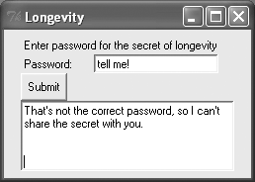
The Longevity Program
Figure 10.11: Sample run of the Longevity Program
With incorrect password, program politely refuses to divulge its secret.
Guide to Programming with Python

Slide 40
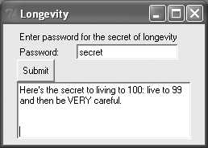
The Longevity Program (continued)
Figure 10.12: Sample run of the Longevity Program
With correct password, program shares its knowledge to long life.
Guide to Programming with Python

Slide 41
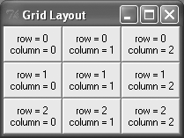
Placing a Widget with the Grid Layout Manager
Figure 10.13: Illustrates placement of button widgets
Frame can be seen as a grid of cells at row and column numbers.
Guide to Programming with Python

Slide 42
Placing a Widget with the
Grid Layout Manager
def create_widgets(self):
self.inst_lbl = Label(self, text = "Enter
password for the secret of longevity")
self.inst_lbl.grid(row = 0, column = 0,
columnspan = 2, sticky = W)
grid() method
  row takes integer; defines the row in which the object is placed (within the widget’s master)
  column takes integer; defines the column in which the object is placed (within the widget’s master)
  columnspan takes integer; defines width in columns
  sticky takes constants (N, S, E, W); positions widget at specified edge of cell (centered by default)
Guide to Programming with Python

Slide 43
Placing a Widget with the
Grid Layout Manager
# create label for password
self.pw_lbl = Label(self, text = "Password: ")
self.pw_lbl.grid(row = 1, column = 0, sticky = W)
Creates a label that appears in row 1, left-justified
Guide to Programming with Python

Slide 44
Creating an Entry Widget
# create entry widget to accept password
self.pw_ent = Entry(self)
self.pw_ent.grid(row = 1, column = 1, sticky = W)
Entry widget accepts and displays line of text
Guide to Programming with Python

Slide 45
Creating a Button Widget
# create submit button
self.submit_bttn = Button(self, text = "Submit",
command = self.reveal)
self.submit_bttn.grid(row = 2, column = 0,
sticky = W)
Bind the activation of button with reveal() method
Place button in next row, left-justified
Guide to Programming with Python

Slide 46
Creating a Text Widget
# create text widget to display message
self.secret_txt = Text(self, width = 35,
height = 5, wrap = WORD)
self.secret_txt.grid(row = 3, column = 0,
columnspan = 2, sticky = W)
wrap parameter determines how text in the box is wrapped
  WORD wraps entire words
  CHAR wraps characters
  NONE no wrapping (can only write text on the first line)
Guide to Programming with Python

Slide 47
Getting and Inserting Text with Text-Based Widgets
def reveal(self):
""" Display message based on password. """
contents = self.pw_ent.get()
if contents == "secret":
message = "Here's the secret..."
else:
message = "That's not the correct..."
self.secret_txt.delete(0.0, END)
self.secret_txt.insert(0.0, message)
Guide to Programming with Python

Slide 48
Getting and Inserting Text with Text-Based Widgets (continued)
get() returns text from text-based widget
delete() deletes text from text-based widget
  Can take single index or beginning and ending point
  Pass floating-point number for row and column
  Tkinter provides constants, such as END
insert() inserts a string into a text-based widget
  Takes an insertion position and a string
  Pass floating-point number for row and column
longevity.py
Guide to Programming with Python

Slide 49
Using Check Buttons
Check buttons allow user to select any number of choices from a group
Provides flexibility for user and control of limiting choices for programmer
Guide to Programming with Python

Slide 50
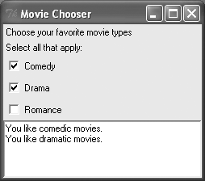
The Movie Chooser Program
Figure 10.14: Sample run of the Movie Chooser program
The results of the user’s selections show up in the text box.
Guide to Programming with Python

Slide 51
Allowing a Widget’s Master to Be Its Only Reference
def create_widgets(self):
Label(self,
text = "Choose your favorite movie types"
).grid(row = 0, column = 0, sticky = W)
Label object
  Not assigned to variable
  Can't be directly accessed
  Connected to the program by its master
Guide to Programming with Python

Slide 52
Creating Check Buttons
# create Comedy check button
self.likes_comedy = BooleanVar()
BooleanVar
  Special class from Tkinter module
  Can reflect check button’s status
  Required by Checkbutton object
Guide to Programming with Python

Slide 53
Creating Check Buttons (continued)
Checkbutton(self,
text = "Comedy",
variable = self.likes_comedy,
command = self.update_text
).grid(row = 2, column = 0, sticky = W)
variable takes BooleanVar for status of check button
command takes function or method to call when check button is checked or unchecked
Guide to Programming with Python

Slide 54
Getting the Status of a Check Button
def update_text(self):
likes = ""
if self.likes_comedy.get():
likes += "You like comedic movies.\n"
BooleanVar
  Can’t access the value directly
  Must invoke object’s get() method
movie_chooser.py
Guide to Programming with Python

Slide 55
Using Radio Buttons
Radio buttons allow user to select one from a group of choices
Provides programmer control by limiting range of choices and allowing only single choice
Guide to Programming with Python

Slide 56
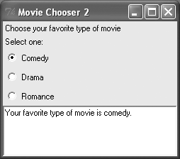
The Movie Chooser 2 Program
Figure 10.15: Sample run of the Movie Chooser program
The user can select only a single movie type.
Guide to Programming with Python

Slide 57
Creating Radio Buttons
# create variable for single, favorite type
self.favorite = StringVar()
StringVar
  Special class from Tkinter module
  Can reflect status of a group of radio buttons
  Required by Radiobutton objects
Guide to Programming with Python

Slide 58
Creating Radio Buttons (continued)
Radiobutton(self,
text = "Comedy",
variable = self.favorite,
value = "comedy.",
command = self.update_text
).grid(row = 2, column = 0, sticky = W)
variable parameter gets StringVar self.favorite
When radio button is selected, StringVar assigned string referenced by object’s value option
When Comedy radio button selected, StringVar self.favorite assigned "comedy."
Guide to Programming with Python

Slide 59
Getting a Value from a Group of Radio Buttons
message = "Your favorite type of movie is "
message += self.favorite.get()
get() method returns string referenced by the StringVar that all Radiobutton objects share
When Comedy radio button selected, self.favorite.get() returns "comedy "
movie_chooser2.py
Guide to Programming with Python

Slide 60
The Mad Lib Program
mad_lib.py
Guide to Programming with Python

Slide 61
Summary
A GUI is a graphical user interface
A widget, short for window gadget, is a GUI element
A master widget contains other widgets
A layout manager controls the arrangement of widgets
An event-driven program responds to actions regardless of the order in which they occur
An event is something that happens involving a program’s objects
Guide to Programming with Python

Slide 62
Summary (continued)
An event handler is code that runs when a specific event occurs
To bind is to associate an event with an event handler
An event loop checks for events and, based on them, calls the appropriate event handlers
Tkinter is a GUI module
A Label object represents a label widget
A Frame object represents a frame widget
Guide to Programming with Python

Slide 63
Summary (continued)
A Button object represents a button widget
An Entry object represents a text entry widget
A Text object represents a text box widget
A Checkbutton object represents a check button widget
A Radiobutton object represents a radio button widget
Guide to Programming with Python

